Slide 1
Strings

Slide 2
Strings So Far
Have only used literal strings, characters surrounded by double quotes
printf(“Hello World!”);
Haven’t assigned a string to a variable
No built-in string type in C

Slide 3
Strings As Arrays
Arrays of characters (with one difference)
“Hello” as a char array:

Slide 4
C Style Strings
Add a NULL character to the end
NULL is the character '\0' (That's a backslash then a zero)
Why don't I write “Hello\0”?
When using strings in quotes, NULL is added for you

Slide 5
Initializing Strings
Writing out the array is too much typing!
I agree, lets use our string shortcut
Can also use a pointer

Slide 6
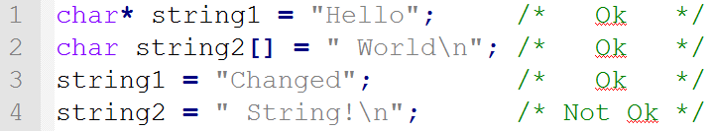
Pointer to char or char Array?
Depends on the situation
If initializing or assigning a string, always use a char*:
Why is the second assignment not ok?
string2 only has enough space for 6 chars, not 9!

Slide 7
Passing Strings To Functions
Passed as char*
No need to pass a length
Just keep going until the NULL terminator/character
Must use pointer arithmetic

Slide 8
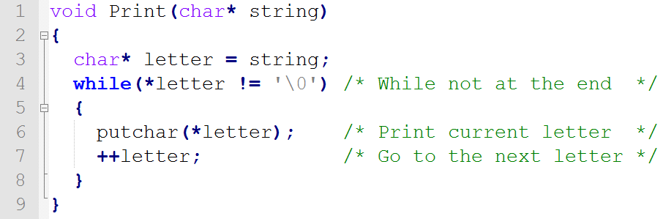
A Very Simple Print
putchar – prints a single char

Slide 9
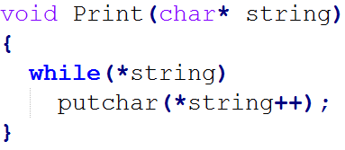
Same Function, Taking Shortcuts
Why can I say while(*string)?
When we hit the NULL terminator, the expression becomes false
Why is it ok to increment string?
It’s a pointer!
Why is *string++ OK?
Operator precedence – it’ll dereference the pointer to get the char and afterwards increment the pointer

Slide 10


Printing Strings With printf
Can print string variables or strings in quotes
Use the format specifier %s:
Can also use puts
Takes a string, does not use format specifiers
Moves to the next line after printing

Slide 11
Getting Strings As Input
Can use scanf, but has problems
gets is a better alternative
Reads everything entered by user until they press enter
Automatically adds NULL character at the end
Must use a char array
Must make sure the array can hold all input!

Slide 12
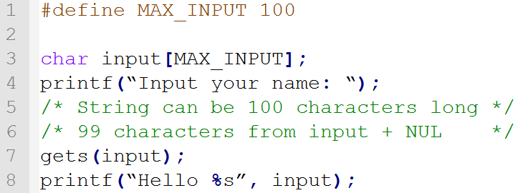
String Input Example

Slide 13
String Functions
There are lots of functions for strings
Defined in string.h (Need to #include <string.h>)
strlen – Count number of characters in the string
strcpy – Copy a string
strcat – Add a string onto the end of another
strcmp – Check if two strings are the same

Slide 14
Summary
Strings are just fancy character arrays
They must end with a NULL terminator
You can pass strings to functions as char pointers

Slide 15
Questions?

